Slide 1
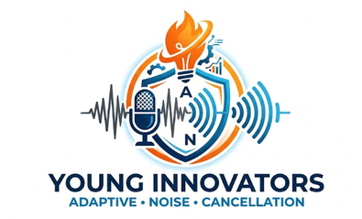



SMART INDIA HACKATHON 2026
AI/ML Adaptive Noise Cancellation for Defence Communications
•Problem Statement ID – SIH26052
•Problem Statement Title-
To develop an AI/ML-enabled adaptive noise cancellation (ANC) system that effectively suppresses stationary, non-stationary, and impulsive defence noises while maintaining high speech intelligibility and real-time performance on embedded hardware
•Theme- Miscellaneous
•PS Category- Hardware
•Team ID- SIH26-A0H-T333
•Team Name (Registered on portal) :Young Innovators

Slide 2
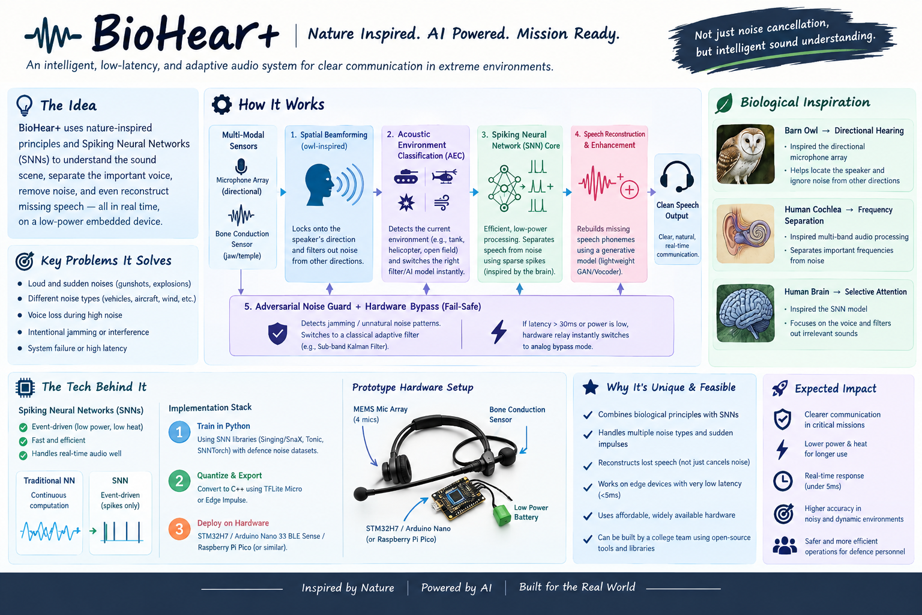
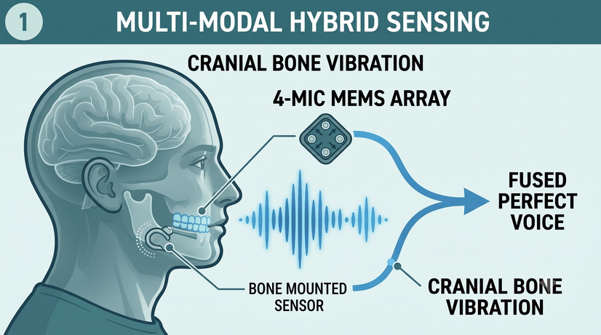
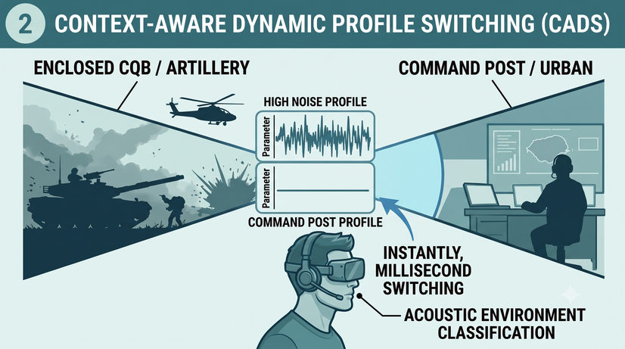
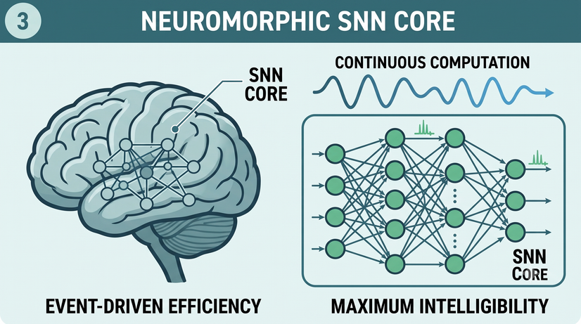
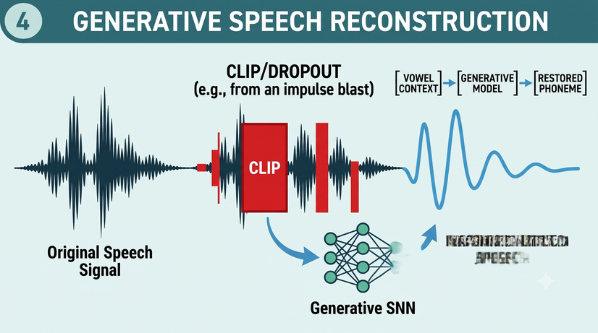
PROPOSED SOLUTION
MOTIVATION TO ADDRESS THE PROBLEM AND GENERATE SOLUTION
  To make communication clear even in noisy environments
  To reduce unwanted noise and make speech easier to hear
  To use AI/ML to handle different types of changing noise
  To provide real-time noise cancellation with very low delay
  To improve safety and communication for defence personnel

Slide 3

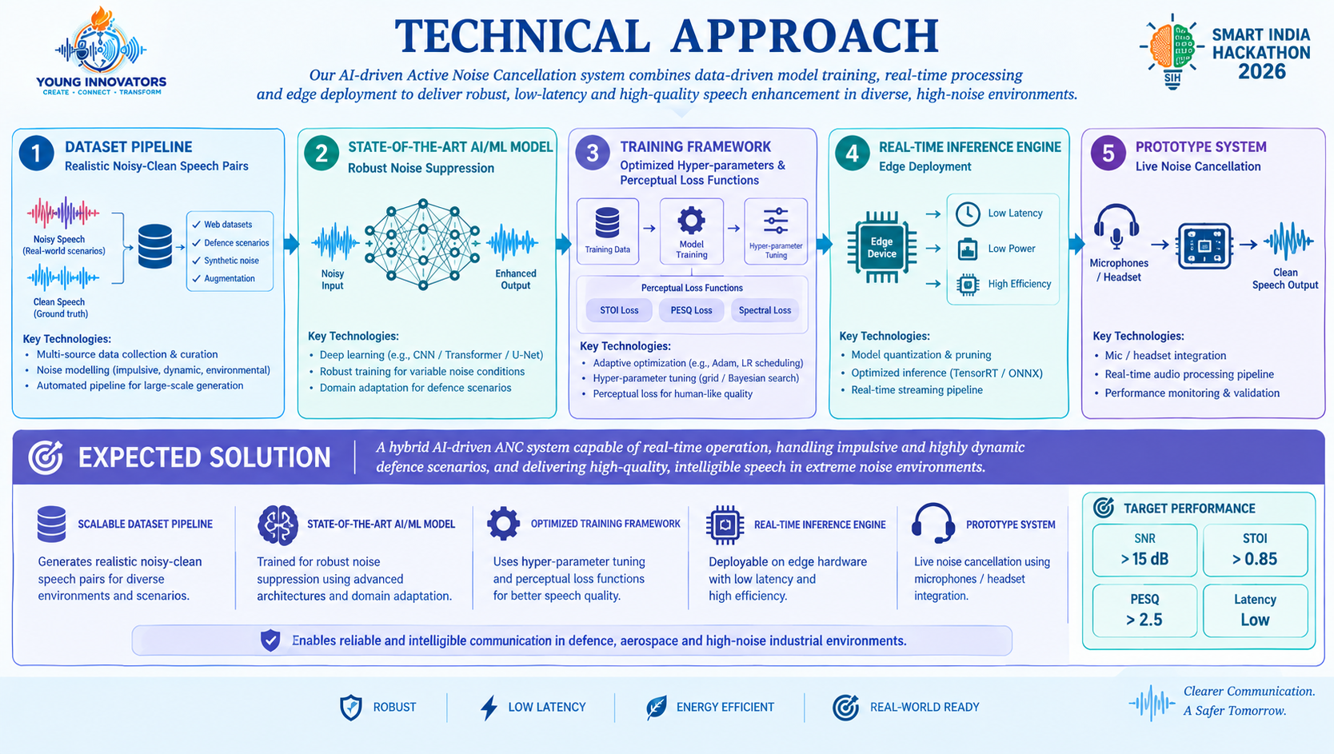
TECHNICAL APPROACH
TARGETED FUNCTIONALITIES

Slide 4
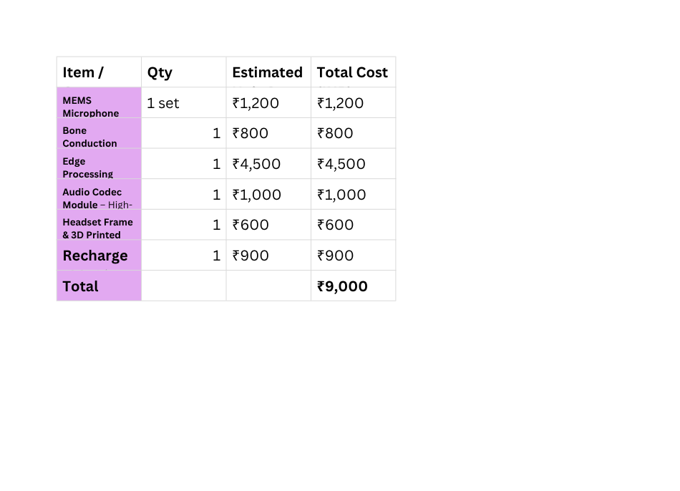
FEASIBILITY AND VIABILITY
Commercial & Market Viability
  Growing Demand: Defence,Aerospace,police,paramilitary, industrial sectors.
  Market size : Global market for speech enhancement and ANC is expected to grow from approx $2.5B (2024) to $6.8B (2030).
  Product Applications: Headsets,vehicle intercom,aircraft,ground forces,disaster response.
  Competitive Advantage : AI+addaptive filtering,low cost ,high performance.
Bill of Materials (BOM) & Cost
Estimation for the Prototype Solution
Technical Performance
& Latency Metrics
Commercial &
market oppurtunities
  Indian defence modernisation(Atmanirbhar bharat).
  Growing adoption of AI/edge devices in defence
  Potential for collabrations with DRDO,BEL,HAL.,etc.
  Scope for wearables,UAVs,and industrial communtcation systems.
  Noise Suppression: Handles stationary + impulsive noise (gunshots,explosions,vehicles)
  Target Performance: SNR>15dB, STOI>0.85, PESQ>2.5.
  Low latency:50 ms (real time communication).
  Model: CRN/DCCRN/Conv-TasNet/Transformer+LMS/NLMS(hybrid).
  Features: Time-frequency +complex domain,phase preservation,multi-band analysis.
Strategic Risk & Insurance Feasibility
OEM Integration & Operational Feasibility
  Technical Risk: Model may underperform on unseen noise types.
  Hardware risk: Edge device limitations (quantization,pruning,TensorRT).
  Operation Risk : Microphone/communication integration and field conditions .
  Assurance: Redundancy(adaptive filter), fail-safe bypass, continuous monitoring.
  Hardware : NVIDIA Jetson Orin/AI SoC/DSP(edge deployment ).
  Software:PyTorch,ONNX,TensorRT,Librosa,NumPy,MATLAB.
  Integration: Microphones (primary+references),hedset/communication unit,audio codec.
  Feasibility: High-standard hardware and open-source tools available .

Slide 5
IMPACT AND BENEFITS
Socio-Economic & Public Safety Impact
  Enhancing Public Safety Operations: Directly supports high-noise emergency and security operations by filtering out chaotic acoustic disturbances like emergency sirens, heavy wind, and industrial chaos.
  Low-Power and Sustainable Hardware: Utilizes efficient, low-power neuromorphic SNN cores and widely available hardware components to ensure extended operational periods for frontline personnel.
  Advanced Acoustic Benchmarks: Delivers exceptional audio enhancement performance targeting SNR > 15 dB, STOI > 0.85, and PESQ > 2.5 to guarantee crystal-clear communications during critical missions.
National Security & Strategic Defence Benefits
  Mission-Critical Reliability for Armed Forces: Enables reliable, highly intelligible communication for military personnel operating in extreme defence, aerospace, and high-noise environments affected by heavy gunfire, artillery fire, and vehicle engines.
  Indigenous Defence Innovation: Replaces imported audio processing setups with local, domestic hardware and native neuromorphic software, building crucial indigenous intellectual property for India's defence sector.
  Tactical Edge Optimization: Leverages lightweight edge hardware and optimization techniques like quantization and TensorRT conversion to meet strict operational latency and power constraints in the field.
Technological Integration & End-User Efficacy
  Hybrid Multi-Modal Sensing: Integrates a 4-mic MEMS array and cranial bone-conduction jaw sensors to fuse pristine input data even under severe dynamic interference.
  Context-Aware Adaptability: Utilizes Context-Aware Dynamic Profile Switching (CADS) to instantly adjust to changing environments—such as enclosed CQB, command posts, or urban sectors—in milliseconds.
  Generative Speech Reconstruction: Employs an on-device contextual AI vocoder to rebuild missing speech phonemes and lost information resulting from sudden noise bursts or signal drops.

Slide 6
RESEARCH AND RESOURCES
Government and Policy Research-
https://idex.gov.in/idex
https://www.makeinindia.com/defense-acquisition-procedure
https://academic.oup.com/milmed/article/183/9-10/e547/4841664
https://www.audiology.org/news-and-publications/audiology-today/articles/military-service-and-hearing-health-the-noise-study/ https://nap.nationalacademies.org/catalog/11443/noise-and-military-service-implications-for-hearing-loss-and-tinnitus
Commercial Software and HIL Hardware Tooling
https://www.speedgoat.com/solutions/industries/consumer-electronics/audio-simulation-control-and-testing https://www.mathworks.com/hardware-support/real-time-simulation-and-testing-with-speedgoat-hardware.html https://www.dspace.com/en/inc/home/products/hw/scalexio.html https://www.mathworks.com/products/connections/product_detail/dspace-hil-test.html https://www.ap.com/analyzers-accessories/apx500/ https://www.ni.com/en/solutions/aerospace-defense/embedded-software-test.html
Biomimetic and Robotics Research Publications
https://iopscience.iop.org/journal/1748-3190 https://www.science.org/journal/scirobotics https://ieeexplore.ieee.org/xpl/RecentIssue.jsp?punumber=8613444 https://ieeexplore.ieee.org/xpl/RecentIssue.jsp?punumber=8860 https://www.frontiersin.org/journals/bioengineering-and-biotechnology/sections/bionics-and-biomimetics https://www.nature.com/natmachintell/
SOME MISCELLANEOUS
https://github.com/jeshraghian/snntorch
https://github.com/ARM-software/CMSIS-DSP ,https://zenodo.org/records/1227121
https://github.com/microsoft/DNS-Challenge,https://github.com/aliutkus/speechmetrics
https://www.itu.int/rec/T-REC-P.862,https://quicksearch.dla.mil/qsDocDetails.aspx?ident_number=35978

